Slide 1
Financial Fraud and Scams
Raveen Wright
Scott Hraha
Emil Aran
Notes:
The Elder Financial Abuse presentation is designed to help protect older adults and their loved ones from scams and elder financial abuse. Learning to spot scams is one of the best ways to help prevent financial abuse from happening to you.
NOTE: When conducting a Hands on Banking financial education activity, you cannot promote any specific Wells Fargo products or services during your presentations.
LESSON CONCEPT – Learning about Elder Financial Abuse, Fraud and Scams
MATERIALS NEEDED
For you:
Personal Computer
Internet Access
Projector
PowerPoint Presentation
Participant
Tablet / Computer with Internet Access (optional)
Handouts
Giveaway Items (optional items ordered from the DUC)

Slide 2

Introduction
Needs vs. wants
Gain an understanding of financial fraud
Learn about common scams
Recognize red flags to avoid being scammed
Taking steps to protect yourself and others against financial exploitation
Learn about helpful resources
Q&A
Notes:
INTRODUCTION
Introduce yourself to the class and share what your role is at Wells Fargo. Share with the class what you’ll be covering today:
Understand what Elder Financial Abuse is
Learn about common scams
Recognize red flags to avoid being scammed
Steps to protect yourself
Learn about helpful resources
Any questions before we begin?

Slide 3
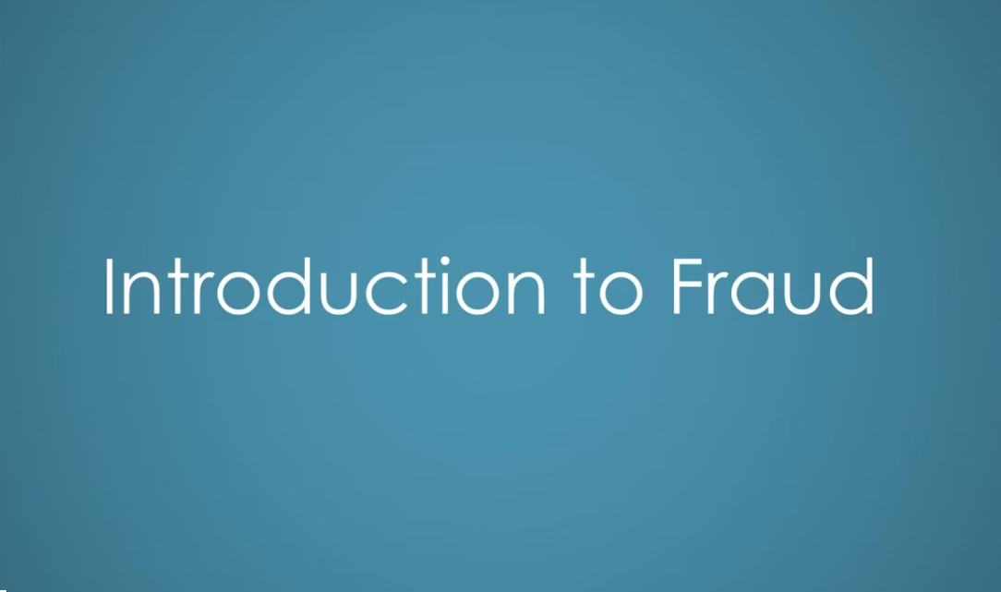
Video – Introduction to Fraud
Needs vs. wants
Notes:
Watch the video about Fraud and lead a short discussion about what they saw.

Slide 4
What is financial elder abuse?
Scams are just one way older adults can fall victim to elder abuse.
What is elder financial abuse?
Taking an older or vulnerable adult’s money or property
Fraudulently signing for elderly people or forging their signatures
Coercing or using undue influence to get an older person to give away assets
Tricking someone to gain their confidence (also known as confidence crimes or “cons”)
What is a scam?
A scam is a trick a con artist plays on an unsuspecting person
The goal is to take money or other assets that does not belong to them
If the scam succeeds, the victim’s money is gone and so is the scammer
A dishonest scheme of any kind tricks someone into giving up their money or belongings
Notes:
Unfortunately, anyone can fall victim to a scam but elder financial abuse occurs when older or vulnerable adults are targeted. Go over the differences between Elder Financial Abuse and Scams.

Slide 5

Why are you being targeted by scammers?
May be more trusting
May be grateful for attention
Tend to have money and time
May be eager to help when they can
Less alert or easily distracted
Not digitally savvy
Unaware of social media risks
Greater isolation
Notes:
Share some of these key ideas:
Being aware of what puts you at risk can save you
Scammers try to outwit you with jargon and fear
Always reach out to someone you trust to double check the facts

Slide 6

Profile of a Scammer
Pinpoints a victim’s vulnerabilities
Quickly gains trust
Shows no mercy and triggers emotion
Makes aggressive demands
Can play upon fears
Use a sense of urgency to dupe people into sending wires, checks, money or gift cards
Notes:
Scammers are A master of persuasion or the ultimate salesperson with a tempting offer.
Share some of these key ideas:
Scammers know the art of telling a good story and how to make a lie seem real
They make the situation seem urgent
They can be very believable – even very smart people get fooled!
They find ways to make you believe them
Always slow down and check in with your instincts if you think you’re the target of a scammer
Call someone you know and trust to discuss before proceeding or giving out money or personal information

Slide 7

How Scammers Find You
Obtain contact information on the dark web
Gain your trust posing as a caregiver, helper, new friend or love interest
Prowl online and on social media sites
Infiltrate groups to which you belong
Go door-to-door
Family and close friends with ill intent
Notes:
People don’t like to talk about the idea that even certain family members or close friends can manipulate and scam older relatives into handing over money or property, but it does happen more often than most people realize. Scammer can be strangers, “new” friends or acquaintances, or even someone you know well.
Share some of these key ideas:
Scammers can use information gathered online or on social media to send you misleading emails or letter, or call you with a story
Other online dangers include: Posting travel dates and photos, family details, use of dating websites, and even details shared on church or hobby groups
Make sure you check backgrounds of new caregivers, handymen, non-profits, or new friends
If you think a family member is trying to scam you, delay the request for money and talk someone you trust

Slide 8
Scammers and Their Victims
Scammers are Highly Skilled | Victims May be Vulnerable
Appeal to emotions: sympathy, fear, and loneliness | May be isolated from friends and family
Don’t take “no” for an answer | Hesitate asking for help
Insist on secrecy | Often ashamed to report a scam
Pretend to care | May have health issues or cognitive decline
Notes:
Anyone can be the victim of a scammer but scammers are experts at identifying signs of vulnerability
Often scammers target victims who live alone or who may have health issues or cognitive problems.
Share some of these key ideas:
Being “catfished” by a person on the internet can happen to anyone – young or old
Catfishing occurs when a scammer uses a fake persona online in an effort form relationships with potential victims
Scammers realize older individuals tend to have more assets they can get their hands on
Share this information with vulnerable neighbors, friends or relatives to keep them informed and vigilant against potential scams

Slide 9

Types of Scams
Gift card scams
Tax Scams
Sweetheart Scams
Grandparent Scams
Current Event Scams
Internet Scams
Winning Prize, Lottery, Free Trips
Imposter Scams
Phony Charities
Investment Tips
Home Repairs
Notes:
Watch out for these commonly used scams targeting older adults. These are the most common types of scams, but stay aware because scammers are always inventing new methods of tricking people to obtain information, money or property.
Share some of these key ideas:
Winning the lottery requires playing the lottery. If you didn’t play the lottery, you didn’t win the lottery!
Before donating to charities do your homework
Double check or get a second opinion on home or car repairs before work is done
If it’s too good to be true, it probably is
Before you give anybody money, slow down and double check with a trusted person
Resist free drawings that require providing personal information

Slide 10

Solving the Scam Problem
Learn how to recognize a scam
when you see it
If it sounds too good to be true, it usually is!
If you see something say something
Double check with a friend before sending money or gift card to someone you don’t know
Do your homework, ask questions, and keep informed
Notes:
The scam problem has one solution: knowing how to protect yourself! Participating in events like this one helps to arm you with knowledge to protect yourself and your loved ones.
Share some of these key ideas:
Learning about scams is one of the best ways to prevent scams from happening to you and those you love
If you think you or someone you know is being scammed, say something or report it to local authorities
If you’ve been scammed, report it and tell others about what happened to help protect others in your community

Slide 11

If You’ve Been Scammed
Remember, you are not alone!
Don’t be embarrassed or afraid
Tell someone you trust
Report the scam to the authorities
Contact the police and federal agencies
Reach out to your financial institutions
Notes:
The more we stay connected to others and discuss potential scams with friends, family and neighbors, the more we can all stay safe.
Share some of these key ideas:
Don’t be silent
If you see something, say something
Always report scams or suspected scams to help put a stop to it

Slide 12

Q&A
Questions?
Notes:
Ask participants if they have any questions.

Slide 13
Thank You / Feedback

Slide 14
Thank you for your support and commitment to providing financial education within our communities! To demonstrate our impact with the work you do, we are collecting volunteer and educator feedback.
Please go to the following page to enter feedback - https://handsonbanking.org/volunteerfeedback/.
Please have your participants go to the following webpage to submit their feedback - https://handsonbanking.org/participant-survey/.
The evaluation does not contain any personal information for participants or you. The evaluation will help us understand participants’ knowledge and confidence about money management topics and will help us better demonstrate the impact of our efforts.
Notes:
After class:
Take a few minutes to ask the teacher or program director how they thought the lesson went. Ask if there are other materials or information you could provide them.
Consider writing a thank you note as a follow-up to your visit.
Submit feedback on your experience at https://handsonbanking.org/employee-volunteer-feedback/
Go to https://wellsfargo.yourcause.com/ and record your volunteer hours.

Slide 15
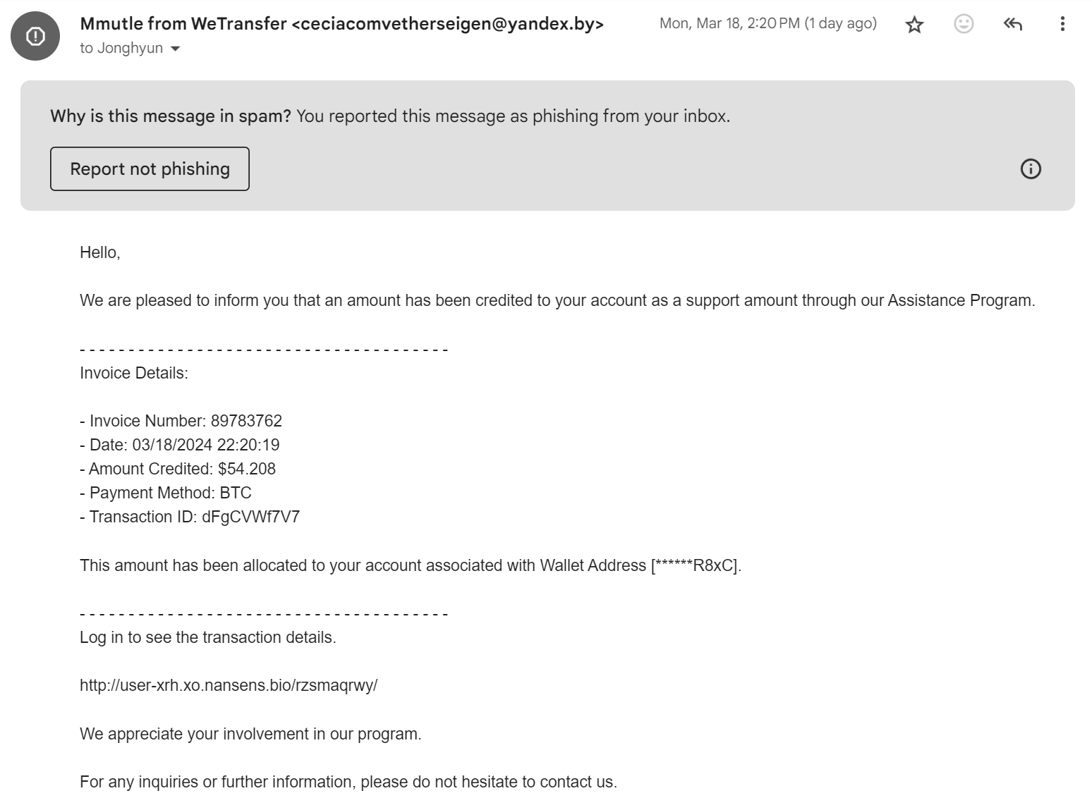
Example Scams

Slide 16
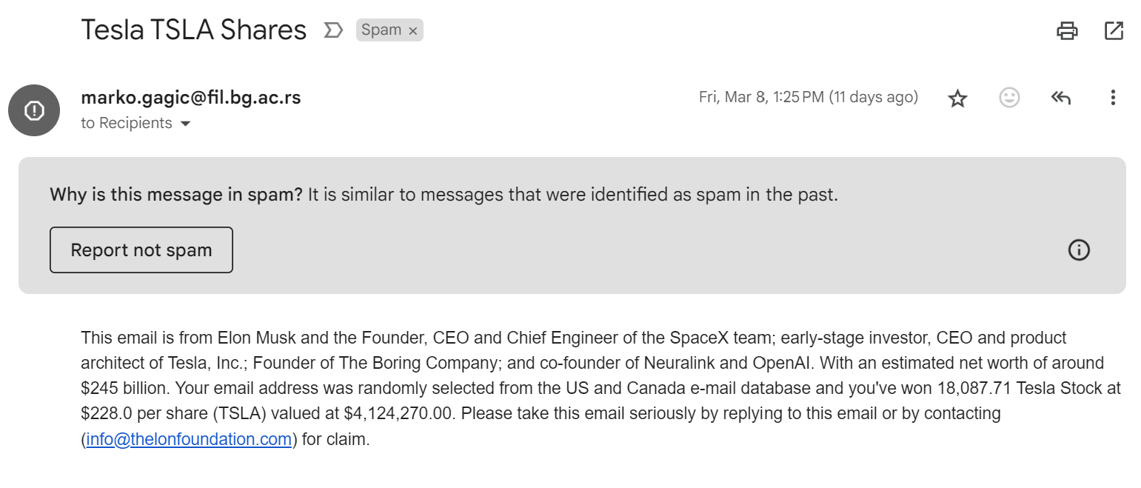
Example Scams

Slide 17
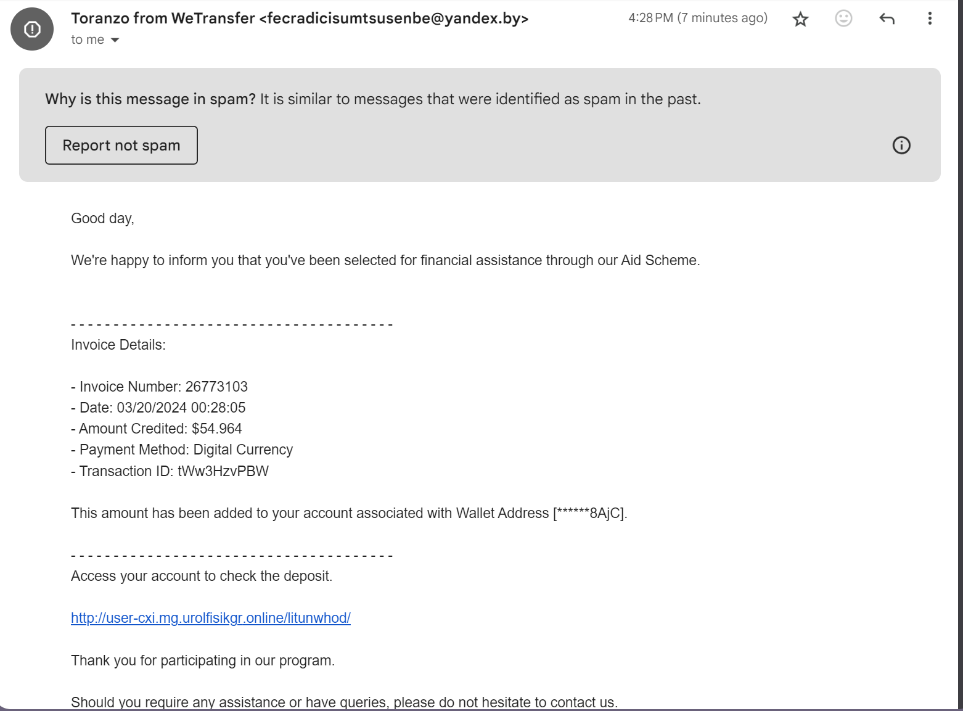
Example Scams

Slide 18
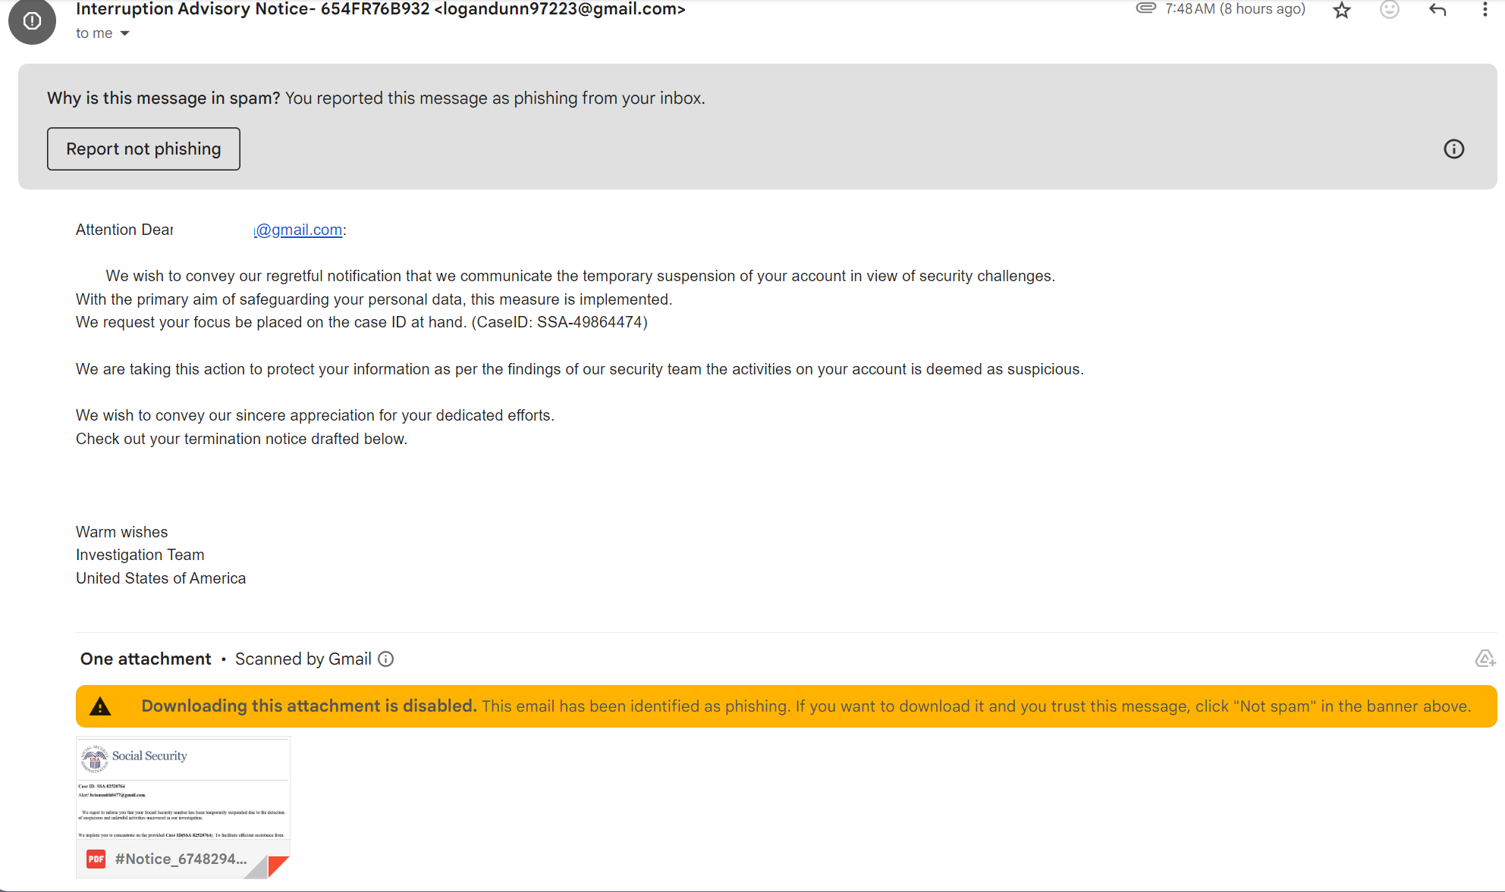
Example Scams

Slide 19
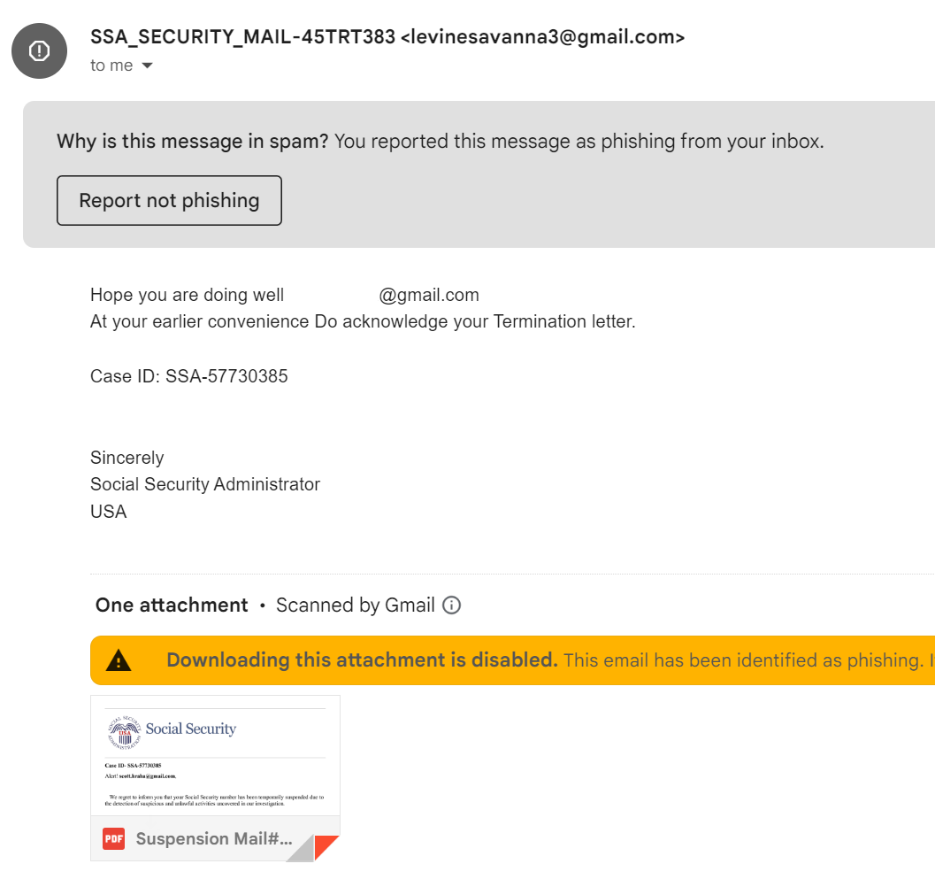
Example Scams

Slide 20
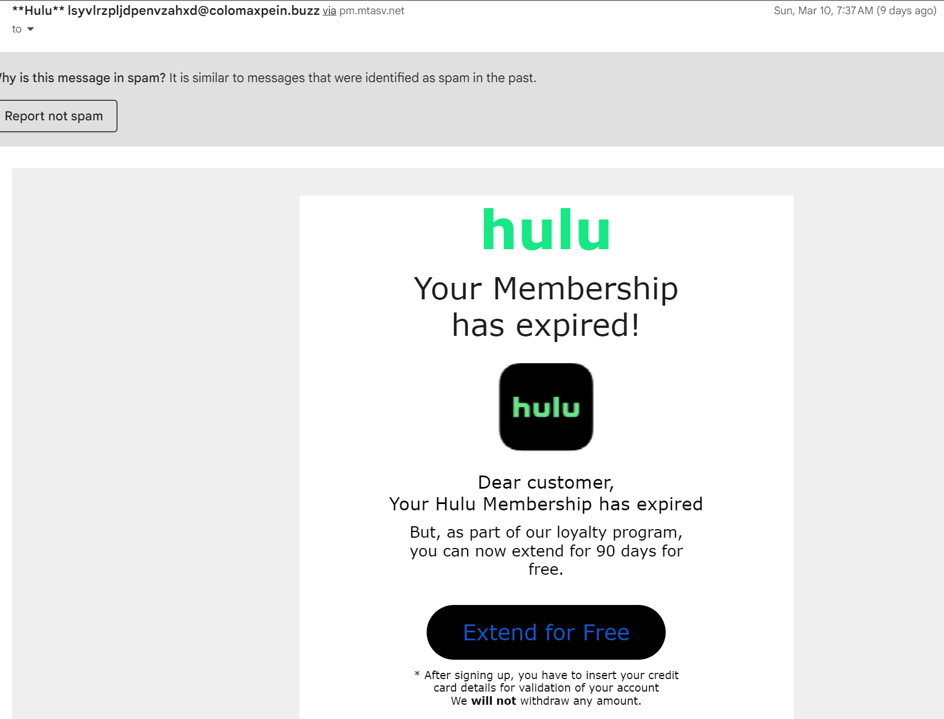
Example Scams

Slide 21
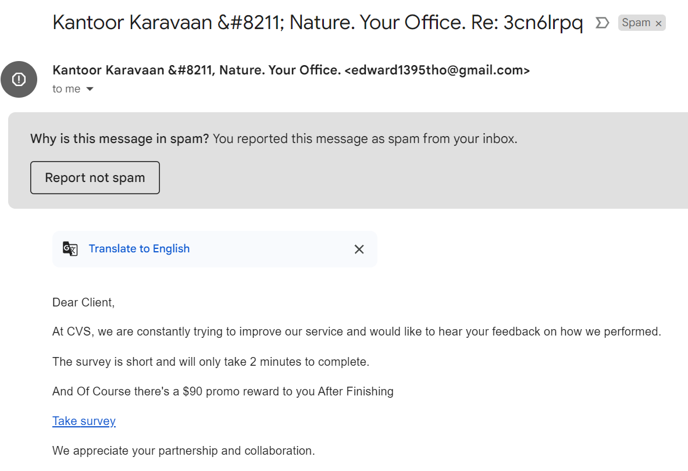
Example Scams

Slide 22
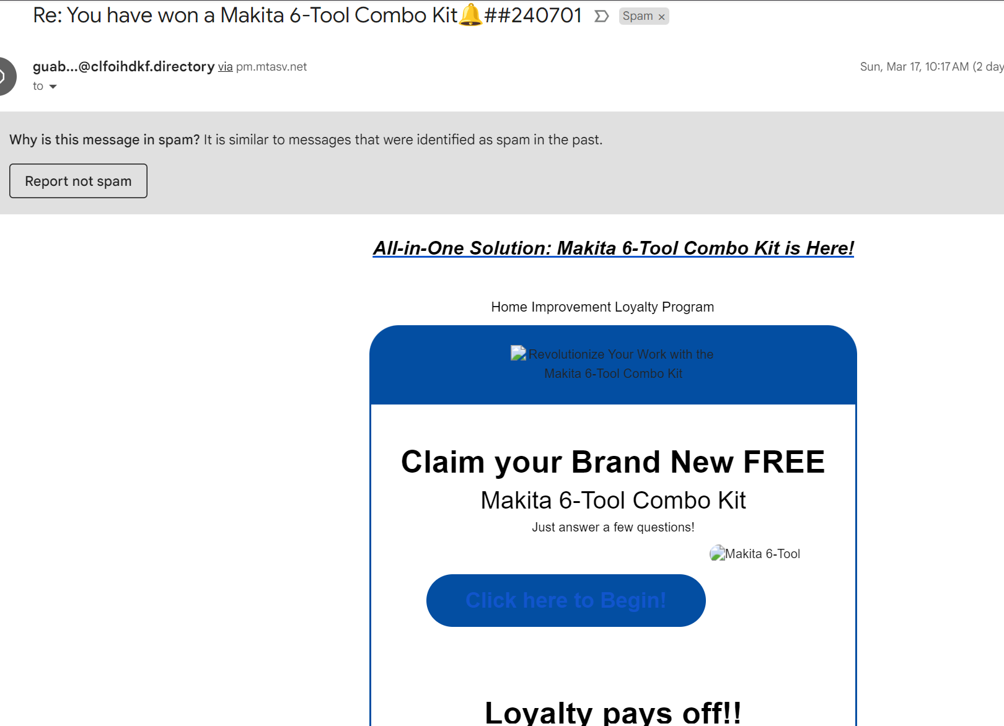
Example Scams

Slide 23
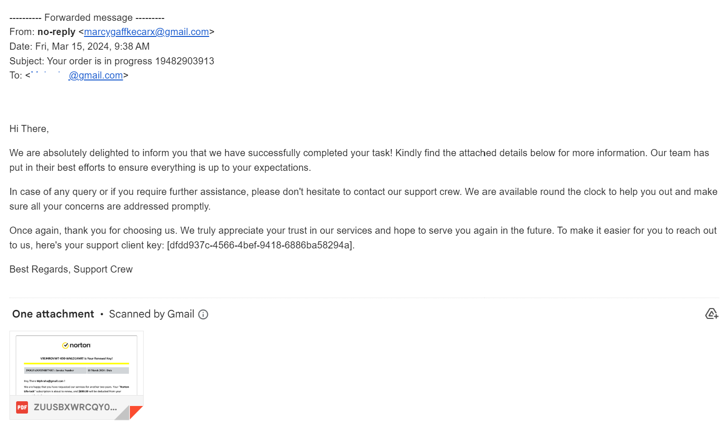
Example Scams

